Slide 1
Sales & Financial Executive Dashboard
Data Analyst Internship | Task 4: Dashboard Design

Slide 2
Objective & Approach
1
Clean the raw data
OBJECTIVE
Design an interactive dashboard for business stakeholders
TOOL
Power BI
DATASET
financial_data.csv, cleaned to financial_data_cleaned.csv
DELIVERABLES
Interactive dashboard + PPT summary
2
Import into Power BI
3
Build KPI cards, slicer and trend chart
4
Summarize the results in this PPT

Slide 3
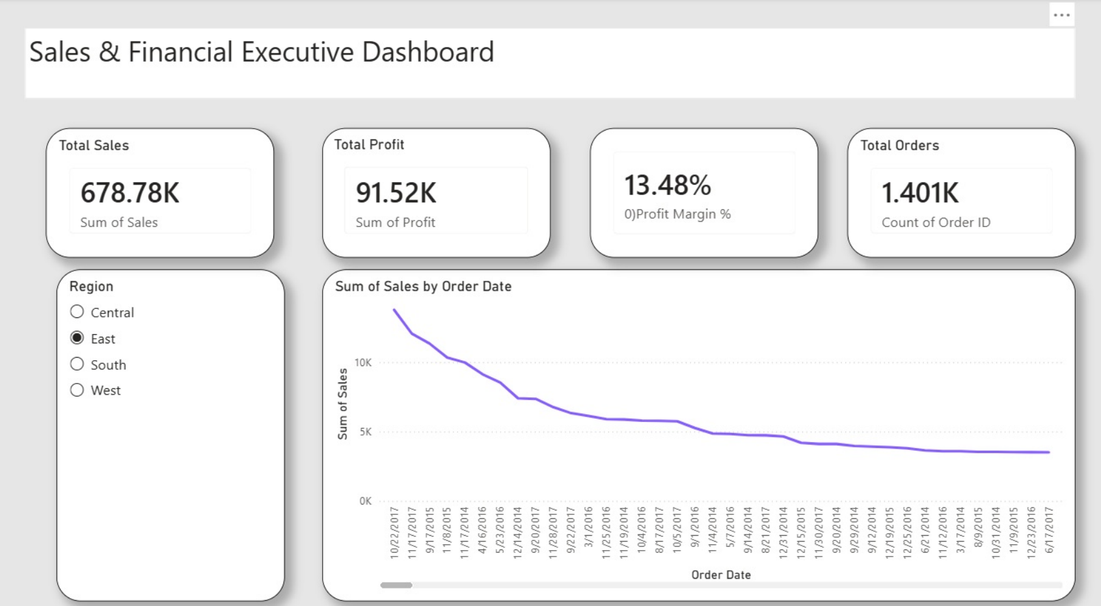
Dashboard Overview
Power BI view with the Region slicer set to East

Slide 4
Key Performance Indicators
TOTAL SALES
TOTAL PROFIT
PROFIT MARGIN
TOTAL ORDERS
678.78K
91.52K
13.48%
1.401K
Sum of Sales
Sum of Profit
Profit ÷ Sales
Count of Order ID
Figures are shown with the Region slicer set to East. Selecting Central, South or West updates every card and the trend chart instantly.

Slide 5
Task Requirements Covered
REQUIREMENT
HOW IT IS MET
STATUS
Right KPIs
Sales, Profit, Profit Margin and Orders
Done
Slicers / filters
Region slicer (Central, East, South, West)
Done
Time-series analysis
Line chart: Sum of Sales by Order Date
Done
Cards for totals
Four KPI cards at the top
Done
Consistent color theme
Rounded cards, grey canvas, purple accent
Done
Navigation menu
Optional, planned as a next step
Next

Slide 6
Key Takeaways & Next Steps
Key takeaways
Next steps
East region delivered 678.78K in sales and 91.52K in profit
Profit margin stands at 13.48% (profit ÷ sales)
1.401K orders are counted in the selected region
One Region slicer lets stakeholders compare all four regions
Sort the trend chart by Order Date (Year → Month) to show true growth
Add a Growth % KPI (year over year)
Add a navigation menu and Category / Segment views
Compare regions side by side with a bar chart

